Slide 1

PINT: Probabilistic In-band Network Telemetry
Ran Ben Basat, Harvard University
Joint work with Sivaram Ramanathan, Yuliang Li (Harvard), Gianni Antichi (QMUL), Minlan Yu, Michael Mitzenmacher (Harvard)
1
Notes:
Hi Everyone, thanks for joining.
Today I’ll be presenting our probabilistic approach for in-band network telemetry.
And this work is really enabled by this new trend of programmable network components we are now seeing

Slide 2
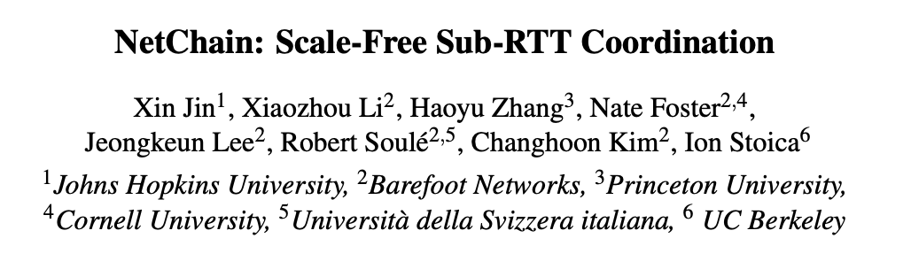
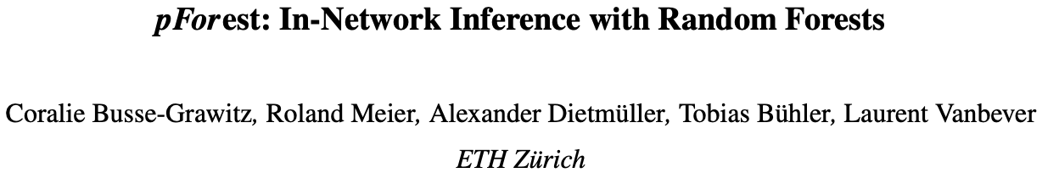

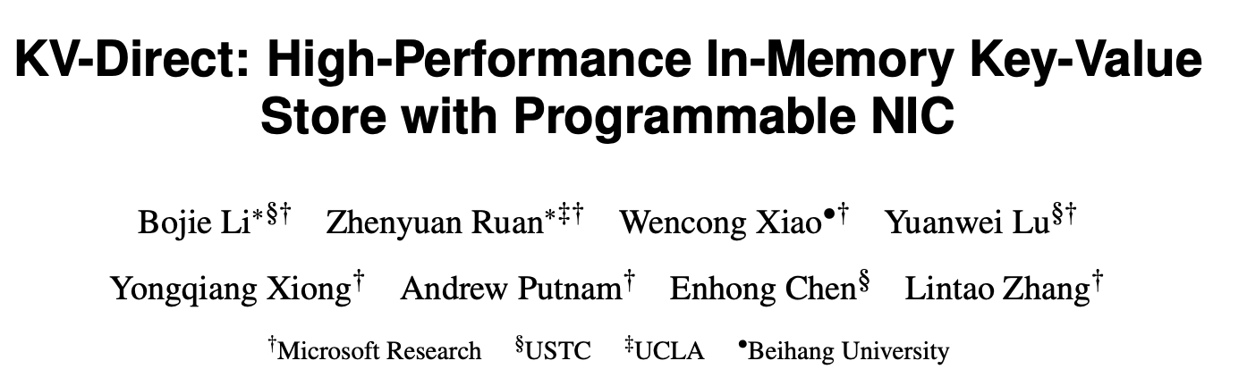

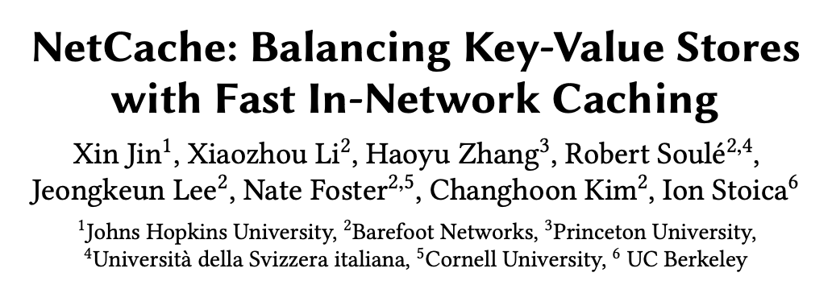

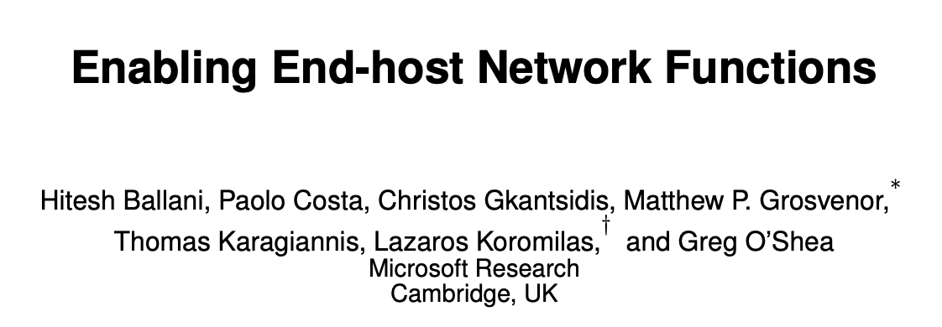


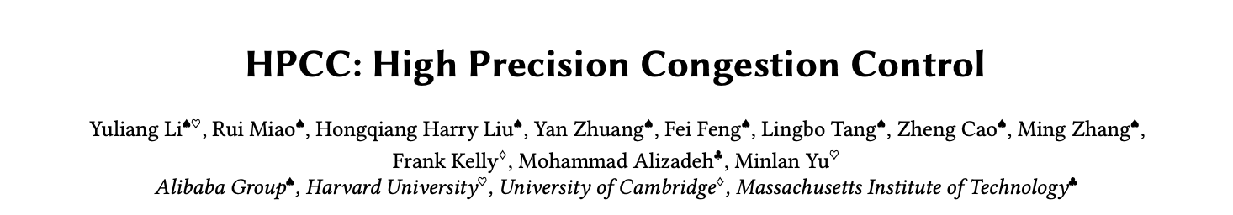
The rise of programmable devices
2
Notes:
We have now programmable switches and smartnics from many different vendors,

Slide 3
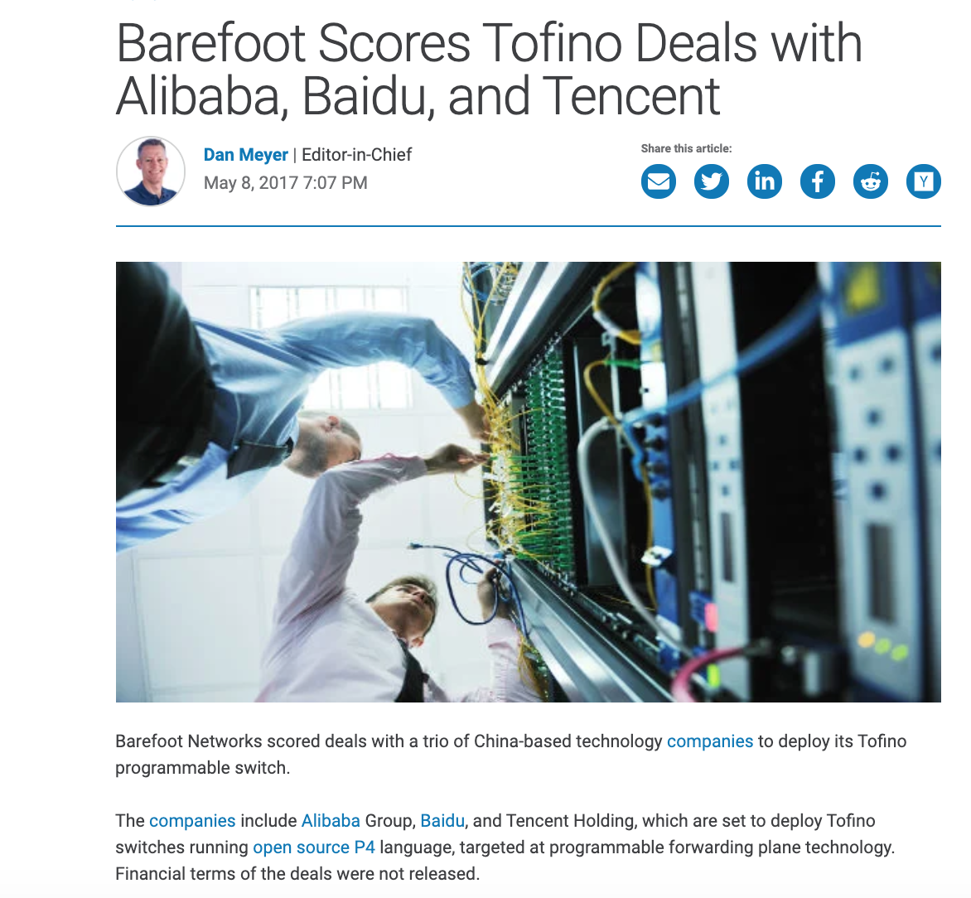
Programmable Data Planes: not an academic dream
3
Notes:
But this is not just an academic game, we now have smartnics deployed in the public cloud

Slide 4
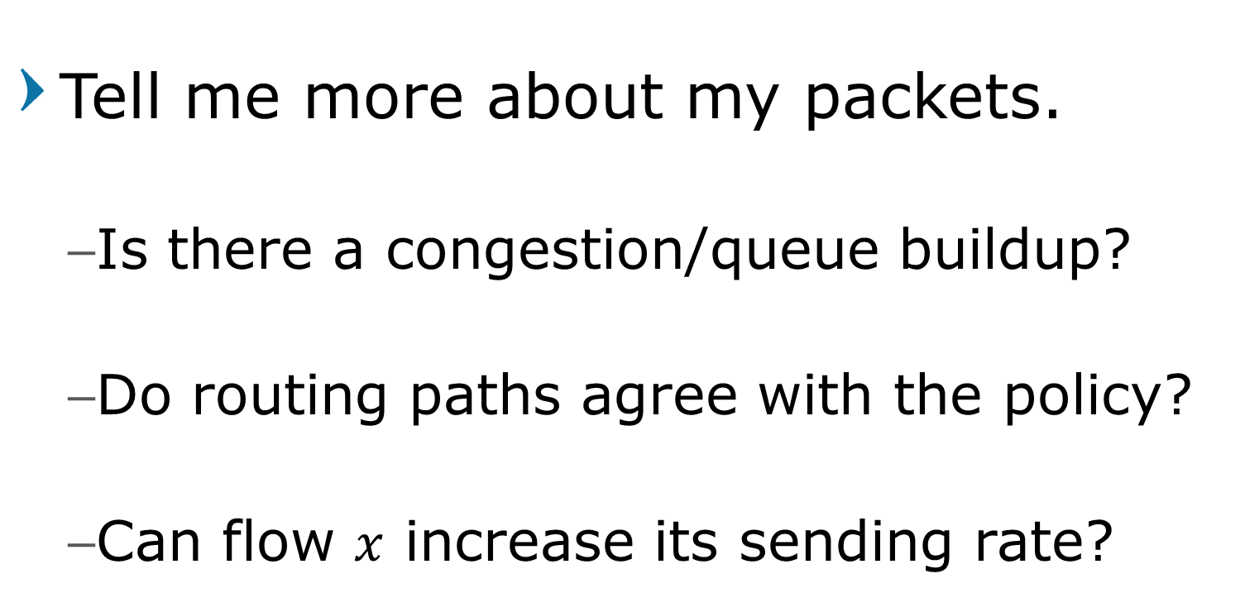
Killer App: Network Telemetry
Tell me more about my packets.
Is there a congestion/queue buildup?
Do routing paths agree with the policy?
Can flow $x$ increase its sending rate?
4
Notes:
So, one of the selling point for these switches is the new and exciting telemetry capabilities.
And telemetry is about knowing my network status.
For example, we want to know if there’s a queue buildup somewhere that is causing congestion, if all routes agree with the policy (e.g., we may want all flows to go through a firewall), and we can even use telemetry to know whether a flow can safely increase its sending rate without causing congestion at any point.

Slide 5
INT: In-band Network Telemetry
Packet
Header
INT
Packet Payload
Add hop information (e.g., switch ID) onto the packet
INT Source
Packet
Header
Packet Payload
INT
INT header
INT metadata value
INT header
Packet
Header
Packet Payload
INT
5
Packet
Header
Packet Payload
INT
INT metadata value
INT header
INT metadata value
INT header
INT metadata value
Notes:
To that end, we have the INT, or In-band Network Telemetry, protocol.
The idea is conceptually simple. If we want to collect date from the network, we can just add it to data packets.
For example, say that we want to discover the path taken by a flow, i.e., collect the switch IDs along the path.
In this case, the first participating hop (which can be either the end host or an ingress switch), which is also called the INT source, adds a new INT header that tells all switches along the path which information we are collecting (i.e., the switch ID). It then adds its own ID, and send the packet to the next hop.

Slide 6
INT: In-band Network Telemetry
Packet
Header
INT
Packet Payload
Add hop information (e.g., switch ID) onto the packet
INT Source
Packet
Header
Packet Payload
INT
INT header
INT metadata value
INT header
Packet
Header
Packet Payload
INT
6
Packet
Header
Packet Payload
INT
INT metadata value
INT header
INT metadata value
INT header
INT metadata value

Slide 7
INT: In-band Network Telemetry
Packet
Header
INT
Packet Payload
Add hop information (e.g., switch ID) onto the packet
INT Source
Packet
Header
Packet Payload
Packet Payload
Packet
Header
INT
INT
INT header
INT metadata value
INT metadata value
INT metadata value
INT header
INT header
Packet
Header
Packet Payload
INT header
INT
7
Packet
Header
Packet Payload
INT
INT metadata value
INT header
INT metadata value
INT header
INT metadata value
Notes:
The next hop reads the INT header, figures out we are collecting switch IDs, adds its own and forwards the packet.

Slide 8
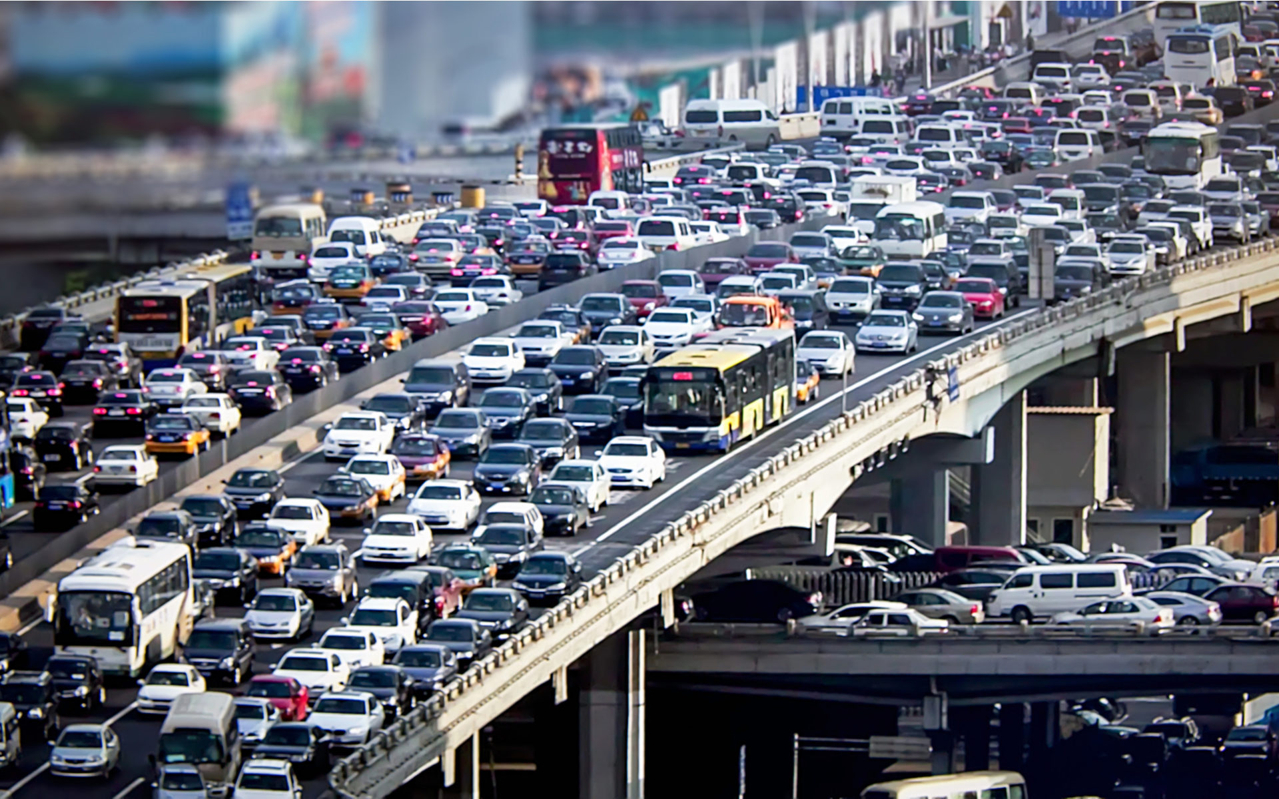
Telemetry Use case #1 – Congestion Control
State of the art: High Performance Congestion Control (HPCC, SIGCOMM 2019) is deployed in production in Alibaba.
8

Slide 9
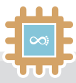

Telemetry Use case #2 – Path Discovery
Which path do my packets take?
Which rules do my packets follow?
Barefoot
Advanced Network Telemetry
Does the path conform with the operator’s policy?
9

Slide 10
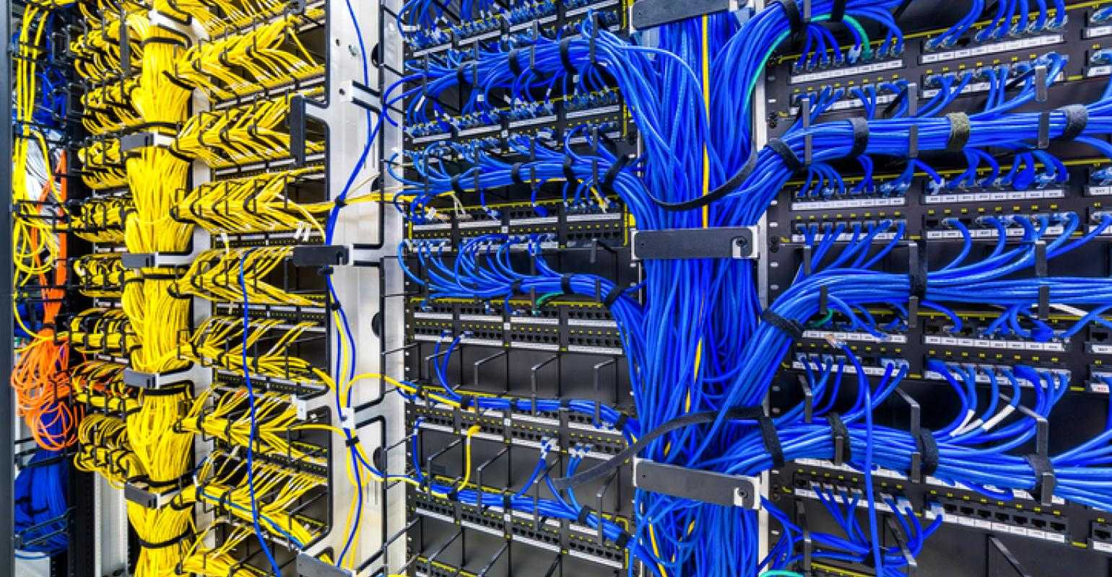

Telemetry Use case #3 – Network Debugging
Identify switches/links with high latency.
Discover load imbalance.
10

Slide 11
INT: In-band Network Telemetry
INT is general
Supports a large variety of functions including latency and buffer measurements.
INT is deployed in major companies such as Alibaba in production.
But introduces high packet overheads.
A single function (e.g., switch ID), adds 4 bytes per hop.
Overhead grows multilinearly with the path length and number of collected telemetry types.
11
Notes:
Add company icons
Discuss use cases here

Slide 12
INT: In-band Network Telemetry
Issue III: High packet overheads degrade application performance.
Packet
Header
Packet Payload
Packet
Header
Packet Payload
INT
Without INT
With INT
12
Notes:
Add company icons
Discuss use cases here

Slide 13
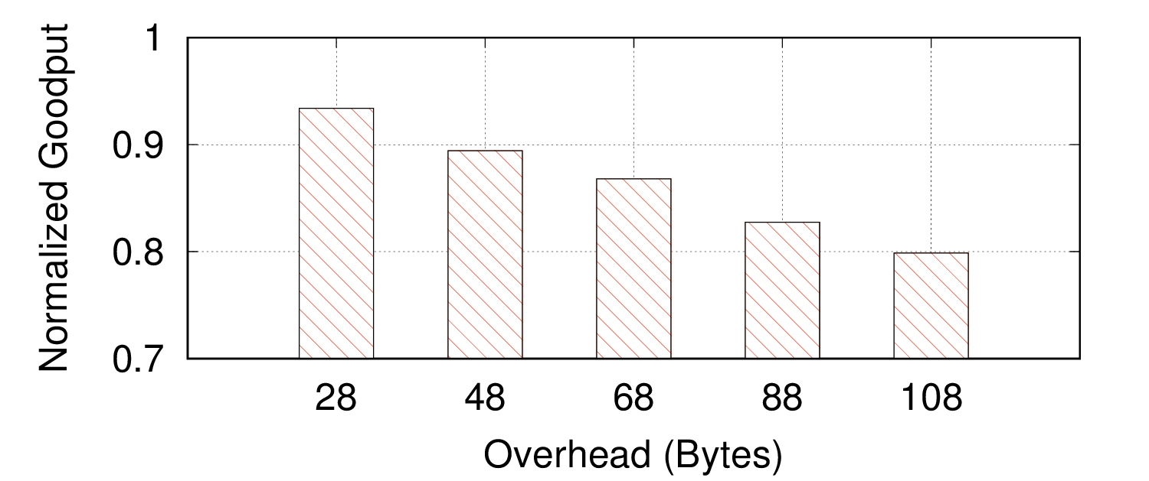
INT Drawbacks
Issue III: High packet overheads degrade application performance.
Path Tracing
HPCC
Both
13
Notes:
5-hop, fat tree, 64 hosts, web search workload, all are standard

Slide 14
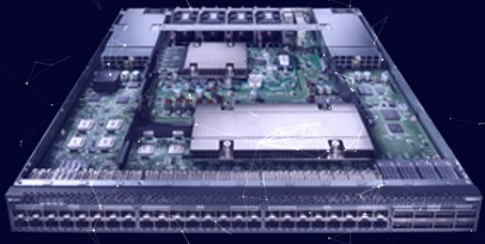
INT Drawbacks
Issue III: High packet overheads degrade application performance.
Issue III: High packet overheads
I
Issue III: High packet overheads increase switch processing time.
Approximately 1% increase per telemetry type on 10G link
INT
Payload
Payload
14
Notes:
Add company icons
Discuss use cases here

Slide 15
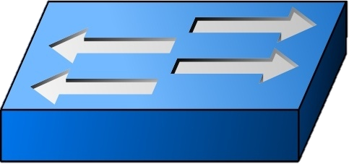






INT Drawbacks
Issue III: High packet overheads
I
Issue III: High packet overheads impose severe collection costs.
Issue III: High packet overheads increase switch processing time.
High network overheads.
High processing overheads.
State of the art telemetry processing (e.g., Confluo, NSDI 2019) rely on fixed byte-size data and are incompatible.
15
Notes:
Add company icons
Discuss use cases here

Slide 16


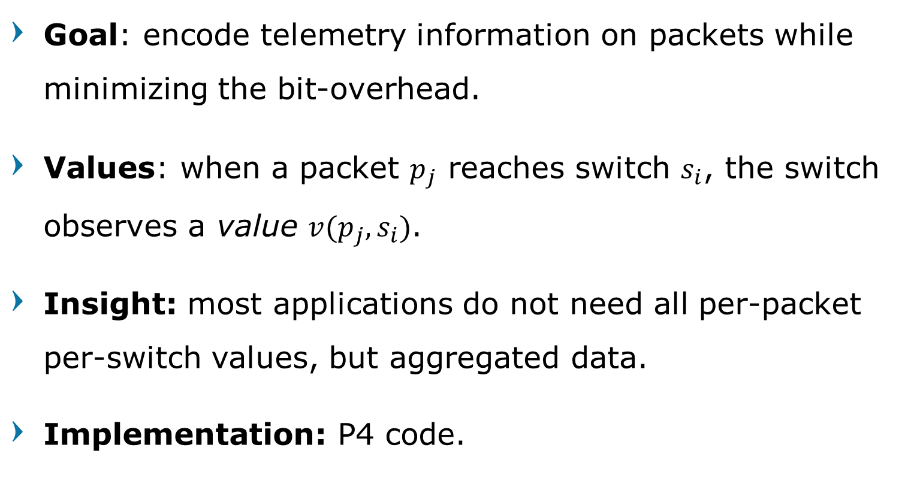
PINT: Probabilistic In-band Network Telemetry
Goal: encode telemetry information on packets while minimizing the bit-overhead.
Values: when a packet $p_{j}$ reaches switch $s_{i}$, the switch observes a value $v(p_{j},s_{i})$.
Insight: most applications do not need all per-packet per-switch values, but aggregated data.
Implementation: P4 code.
16

Slide 17
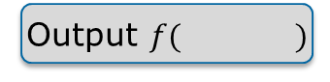
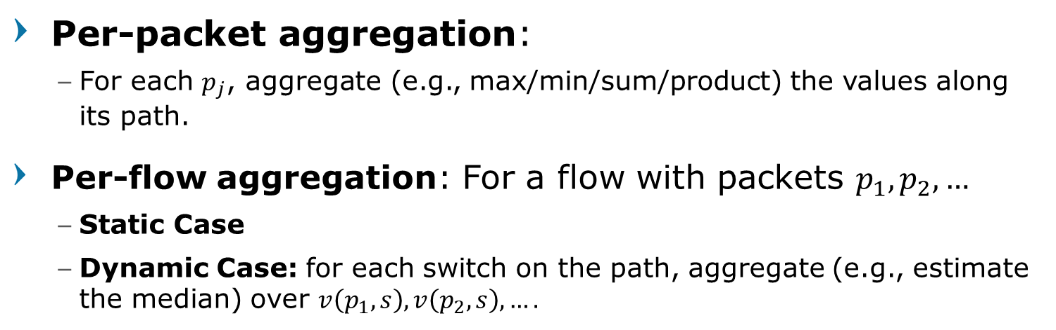
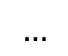
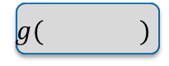
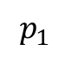

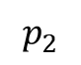


PINT: Probabilistic In-band Network Telemetry
Per-packet aggregation:
For each $p_{j}$, aggregate (e.g., max/min/sum/product) the values along its path.
Per-flow aggregation: For a flow with packets $p_{1},p_{2},…$
Static Case
Dynamic Case: for each switch on the path, aggregate (e.g., estimate the median) over $v\left(p_{1},s\right),v\left(p_{2},s\right),….$
: compute $v(p_{1},s)$ for each switch on the path.
Switches
Packets
Per-packet
$$p_{1}$$
Output $f( )$
Static Per-flow
$$p_{2}$$
Output
$$…$$
Dynamic Per-flow
$$g( )$$
$$g( )$$
$$g( )$$
$$g( )$$
17
Notes:
Visualize

Slide 18
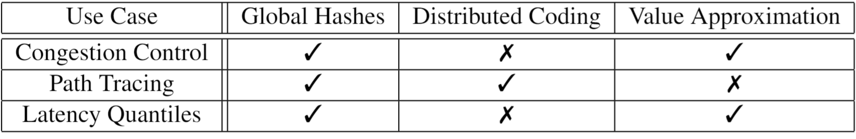
Techniques
Global hash functions allow implicit switch agreement, e.g., on the query type.
Approximations can reduce bit-overhead for numerical values.
Coding helps reduce spreading out static information on multiple packets.
18

Slide 19
PINT solves the overhead issues
The lower overhead reduces the goodput degradation significantly.
By lowering the packet overhead, PINT reduces the switch processing time.
PINT produces less information with fixed-size packet digests and reduces the collection overheads.
19
Notes:
Visualize

Slide 20
Use case 1: Congestion Control (per-packet aggregation)
Alibaba’s HPCC uses INT to collect latency and queue information to determine the sending rate.
The relevant quantity can be expressed as a MAX over a value that is approximated at switches for each packet.
20
Notes:
10% between each consecutive ticks

Slide 21
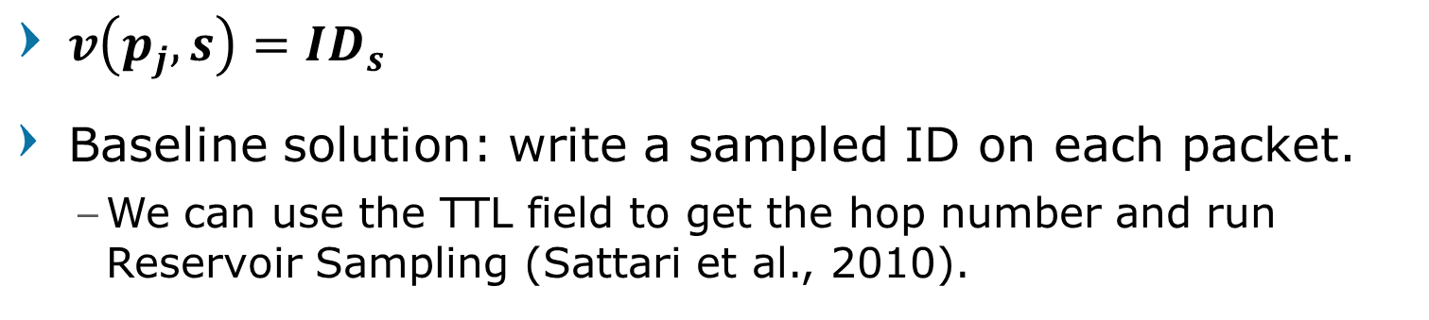

Use case 2: Path Discovery (static per-flow aggregation)
$v\left(p_{j},s\right)=ID_{s}$
Baseline solution: write a sampled ID on each packet.
We can use the TTL field to get the hop number and run Reservoir Sampling (Sattari et al., 2010).
A
B
C
D
C
A
A
D
A
C
B
A Coupon Collector process. For $k$ hops it will take $\operatorname{kln}{k}(1+o\left(1\right))$ packets to detect the path.
21
Notes:
RS allows us to get exact uniform distribution even though switches don’t know the path length
Static case is a generalization

Slide 22
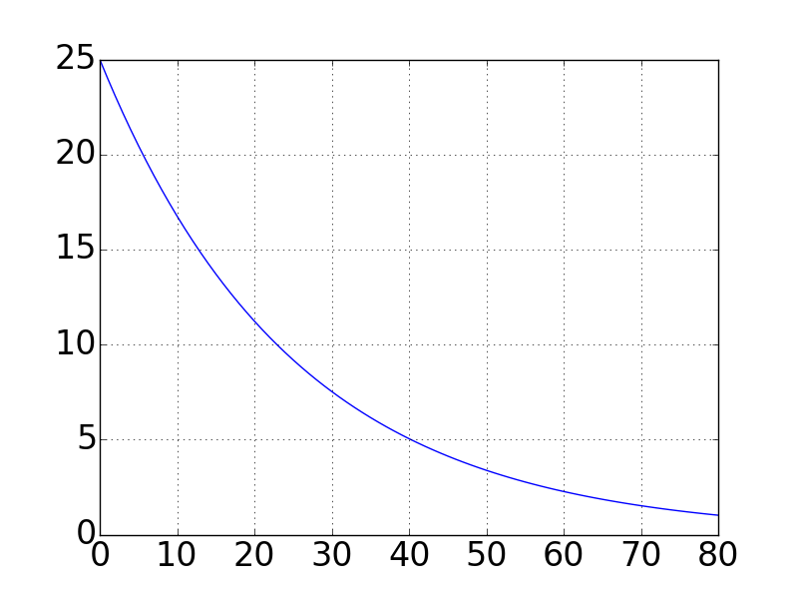
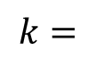
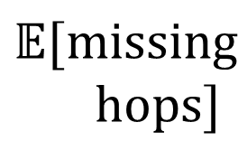
Coupon Collector Process
$$k=$$
$$𝔼[missing$$
$$hops]$$
Number of samples
22
Notes:
In some topologies, we may do better

Slide 23

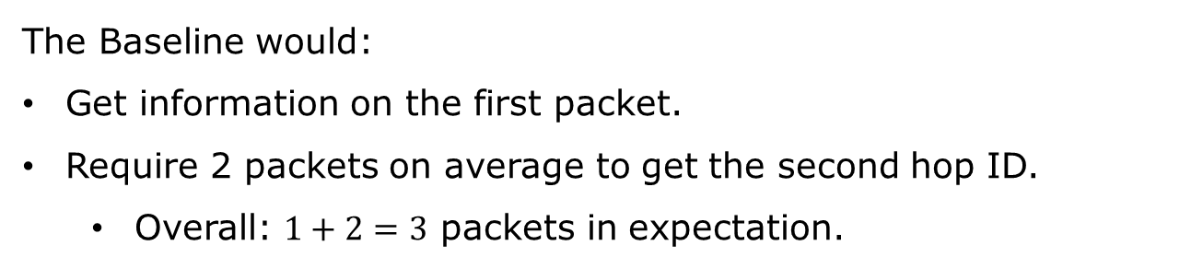



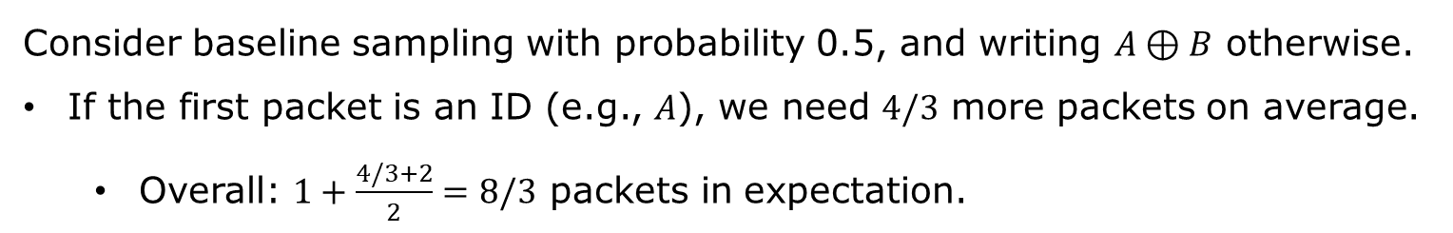
The power of Coding
A
B
The Baseline would:
Get information on the first packet.
Require 2 packets on average to get the second hop ID.
Overall: $1+2=3$ packets in expectation.
$$A$$
$$A$$
$$B$$
Consider baseline sampling with probability 0.5, and writing $A⊕B$ otherwise.
If the first packet is an ID (e.g., $A$), we need $4/3$ more packets on average.
Overall: $1+\frac{4/3+2}{2}=8/3$ packets in expectation.
$$A$$
𝐴⊕𝐵
23

Slide 24

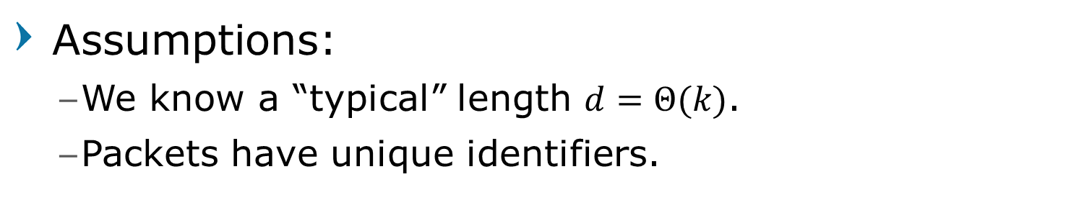

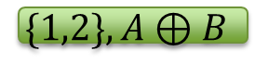
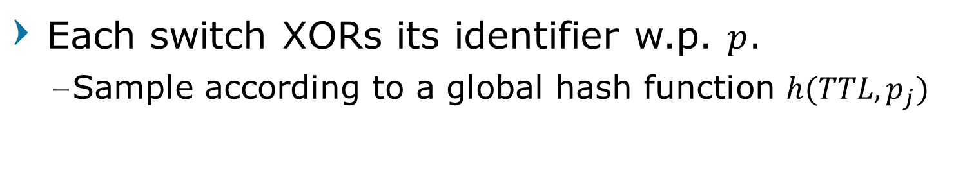
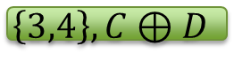
Path Profiling – the XOR algorithm
Assumptions:
We know a “typical” length $d=Θ(k)$.
Packets have unique identifiers.
Each switch XORs its identifier w.p. $p$.
Sample according to a global hash function $h(TTL,p_{j})$
A
B
C
D
$$\{1,2\},A⊕B$$
$$\{3\} ,C$$
$$\{\},0$$
$$\left\{3,4\right\},C⊕D$$
24

Slide 25

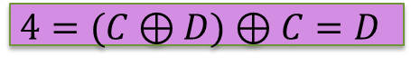
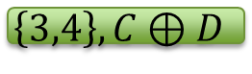
Path Profiling – the XOR algorithm
Assumptions:
We know a “typical” length $d=Θ(k)$.
Packets have unique identifiers.
Each switch XORs its identifier w.p. $p$.
Sample according to a global hash function $h(TTL,p_{j})$
A
B
C
D
$$\{1,2\},A⊕B$$
$$\{3\} ,C$$
$$4=(C⊕D)⊕C=D$$
$$\{\},0$$
$$\left\{3,4\right\},C⊕D$$
25
Notes:
ID can be 5-tuple / IPID / TCP seq / etc.

Slide 26
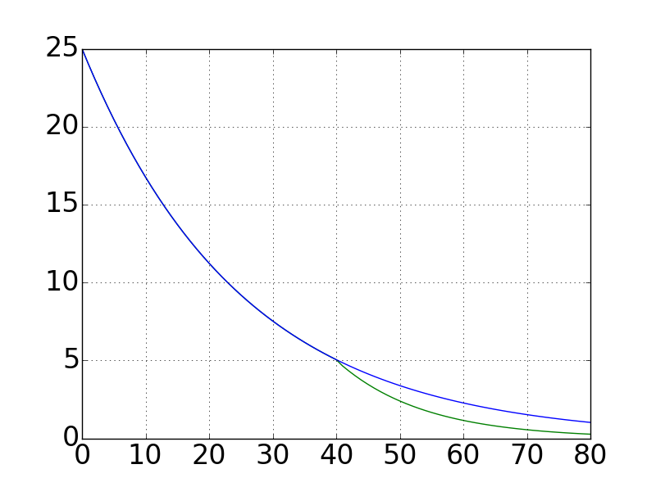
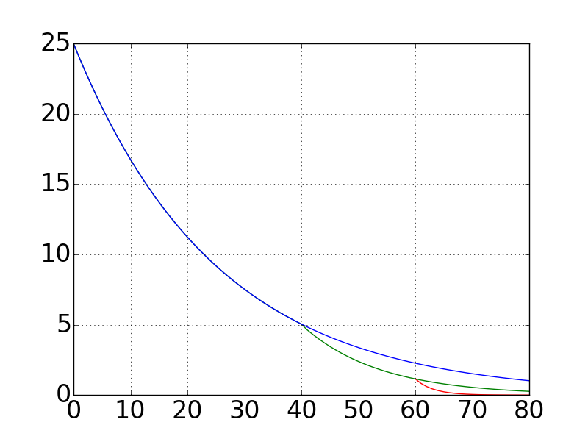
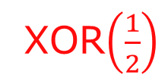
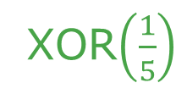
Improving the Coupon Collector
Baseline
XOR$\left(\frac{1}{5}\right)$
XOR$\left(\frac{1}{2}\right)$
$$𝔼[missing$$
$$hops]$$
Number of samples
26

Slide 27

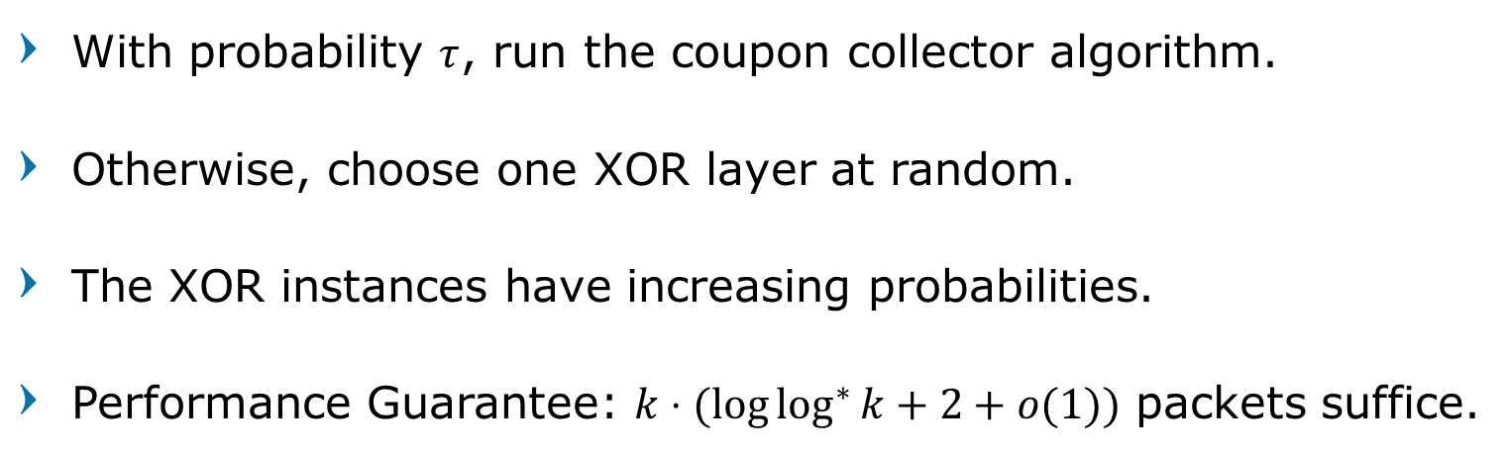
Complete Algorithm
With probability $τ$, run the coupon collector algorithm.
Otherwise, choose one XOR layer at random.
The XOR instances have increasing probabilities.
Performance Guarantee: $k⋅(log{\log^{∗}{k}}+2+o(1))$ packets suffice.
$$…$$
XOR2
XOR1
Coupon collector
27
Notes:
Add a results slide

Slide 28
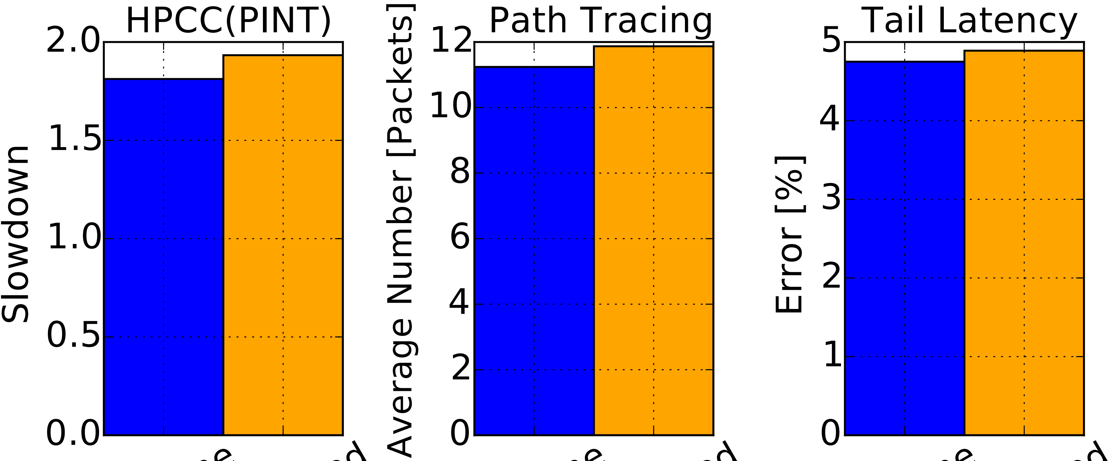
Also in the paper
Algorithms for dynamic aggregation.
Performance guarantees.
Support for concurrent queries.
Standalone
Concurrent
Standalone
Concurrent
Standalone
Concurrent
28

Slide 29


